Slide 1





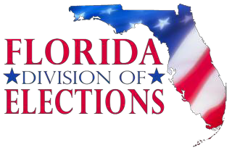
FLORIDA DEPARTMENT of STATE
Public Libraries as
Voting Sites and Voter Registration Agencies
Secretary of State Laurel Lee
Maria Matthews, Esq., Division of Elections
Amber Marconnet, Division of Elections Assistant Director
Katrina Ferguson, Statewide Training NVRA Coordinator Updated October 2020

Slide 2
Table of Contents
Section One: Public Libraries as Voting Sites
Section Two: Public Libraries as Voter Registration Agencies Section Three: Duties of Library as Voter Registration Agency Section Four: How to Assist Voter Applicant
Section Five: Non-Compliance
Section Six: Key Dates and Contact Information

Slide 3
Public Libraries as Voting Sites
SECTION ONE

Slide 4
Serving as a Voting Site
A public, tax supported building like a public library may be enlisted to serve :
  As an optional early voting site during early voting period
    Be geographically located to provide voters equal opportunity to vote
    Selected at least 30 days in advance of election day
  As a polling place on Election Day
    12 hours (7 AM – 7 PM)

Slide 5
When is Early Voting
For federal and state elections:
  Mandatory days: 8 days (10th through the 3rd day before
election)
  Optional days that Supervisor may add: 15th, 14th, 13th, 12th, 11th day or 2nd day (Sunday) before election
  Hours: Minimum 8 hours – Maximum 12 hours
For county, municipal, and special district elections:
  Optional (if held separately from an election in which there is a federal or state race)
  If provided, discretion to choose hours

Slide 6
How to Serve as a Voting Site
Contact your Supervisor of Elections Execute unless they have already reached out to you
Execute contract or agreement
  Facilitates communication
  Minimizes misunderstanding
  Establishes good working relationship from the start
Terms including but not limited to
  Respective duties of SOE Staff and Library Staff
  Security
  Dates and times of operation
  Reimbursement, if any, for costs beyond regular operations

Slide 7
Operating Concurrently
Limit or exclude library services (including cleaning services) from the polling room during voting hours, or for the entire length of early voting, depending on the room’s regular function (i.e. access to a book drop)
Do not schedule meetings, events, or other gatherings during the early voting period, otherwise continue regular operations and hours during early voting
Be aware that voters waiting in line when the site
closes are still allowed to cast a ballot

Slide 8
What do Election Workers do
Control access to polling rooms to only authorized
persons:
  Voters
  Voter’s caregivers (if assistance is required by the voter)
  Someone in the care of a voter
  Poll watchers
  Poll workers
  SOE staff
  Law enforcement and emergency service personnel
  (with SOE permission)

Slide 9
What do Election Workers do
(continued)
Mark boundaries for no solicitation zone within 100 foot of entrance to polling room entrance (§ 102.031, Fla. Stat.)
Maintain cleaning of polling room in library
Maintain order in the polling room in library

Slide 10

Securing the Site
Locks to early voting rooms:
  Supervisors replace locks to early voting rooms with own locks before election
  Library restores locks after election with own locks
Access:
  Poll workers, clerks, and elections officials are the only persons with key access to early voting room
Unlocking/locking library facility:
  Library‘s staff responsibility

Slide 11
Timeline and Activities for
Elections’ Office to Prepare
10-12
months
1-2
months
Notify County Manager, Public Service Administrator, and Library Director, of facility use, dates, and times
Notify individual library contacts of election phone line activation and testing. Give reminders of dates and times
1 week
Notify individual library contacts of equipment delivery and changing of locks
3-4 days
Direct locksmith to change locks on doors to early voting rooms and
coordinate delivery of equipment
1-2 days
Coordinate access to polling rooms for limited room setup with
library staff, as applicable
During EV period
Discuss any challenges or issues that arise during EV
Post- election
Retrieve equipment from site and restores locks

Slide 12
For Election Day
Similar to serving as an early voting site
Similar procedures, duties, and steps
Polling place hours are 7 am to 7 pm (local time)
  Polling place set-up - no later than 6 am (local time)
  Polling place breakdown - may extend several hours into evening
For further information, contact your local SOE
  dos.elections.myflorida.com/supervisors

Slide 13


Slide 14
Public Libraries as Voter Registration Agencies (VRAs)
SECTION TWO

Slide 15
National Voter Registration Act
(NVRA) (52 U.S.C. § 20501 - 52 U.S.C. § 20511)
Enacted in 1993:
  Florida adopted state version in 1995 (Chapter 94-224, Laws of Florida; § 97.057, Fla. Stat.)
Introduced national voter registration standards including allowing voters to register:
  By mail
  At the same as getting driver licenses or renewals (known
as “Motor Voter” part of the law) or
  At the same time as receives services from governmental or public offices/agencies designated by law as Voter Registration Agencies (VRAs)

Slide 16




Types of VRAs
Offices that provide public assistance
Department of Health’s Special Supplemental Food Program for Women, Infants, and Children
Department of Children and
Families:
  Supplemental Nutrition Assistance Program
  Medicaid/Kidcare Medicaid Program
  Temporary Cash Assistance
Program
Offices that provide state funded programs for persons with disabilities
Agency for Persons with Disabilities
Department of Veteran’s Affairs
Department of Education:
  Division of Blind Services
  Division of Vocational Rehabilitation
Department of Financial Services
– Division of Workers’
Compensation
Disability offices at public colleges and universities

Slide 17






Types of VRAs (continued)
Public Libraries
Armed Forces Recruitment Offices
Army
Navy
Marines
Coast Guard
National Guard
Centers for Independent Living
•Umbrella organization-Florida Association of Centers for Independent Living
•Federally mandated under s. 725, 1973
Rehabilitation Act
Operate under slightly different rules than other VRAs
Includes county libraries and municipal libraries

Slide 18
Public library for purposes of VRA
Library established under state law or regulation that serves a community, district or region, and provides at least the following:
  An organized collection of printed or other library materials, or a combination thereof
  A paid staff
  An established schedule during which staff services are available to the public
  Has the facilities necessary to support collections, staff
and schedules
  Is supported in whole, or in part, with public funds
(Includes county and municipal libraries --Does not include academic libraries)

Slide 19
Duties of a Public Library as a VRA
SECTION THREE
20

Slide 20
Duties - Federal and/or State
Designate a NVRA coordinator who:
  Identifies agency staff whose duties involve offering new or renewal of agency services, or address updates for services
  Provides training to staff on voter registration responsibilities
  Notify the Division of Elections at any time there is a
change in coordinator and contact information

Slide 21
Duties - Federal and/or State
(continued)
Offer voter registration opportunities in with same level of help and same points of access as other core agency services
Accept all applications delivered by mail or provided
in person
Forward all applications (complete and incomplete) to your county supervisor of election within five calendar days

Slide 22
Duties - Federal and/or State
(continued)
Report quarterly on voter registration activities
If your library has entered into an agreement to act as a satellite office for social services (i.e. Access Florida), additional duties may apply:
  Contact Division of Elections for more information

Slide 23
Activity Reporting
For each public library in county, record number of applications collected and forwarded to local SOE
Email reports quarterly to DOE:
  VRA.Reporting@DOS.MyFlorida.com
  No specific form required
  Branch library reports to its regional office, which will send reports to DOE
QUARTER | COVERAGE PERIOD | REPORT DUE DATE
1ST Quarter | January 1 – March 31 | April 15
2ND Quarter | April 1 – June 30 | July 15
3RD Quarter | July 1 – September 30 | October 15
4TH Quarter | October 1 – December 31 | January 15

Slide 24
Statutory Cites
Federal Law – National Voter Registration Act, 52 U.S.C. § § 20501 – 20511
https://uscode.house.gov/view.xhtml?path=/prelim@title52/subtitle2/chapter205&edition=prelim
State Law – Section 97.058, Florida Statutes
http://www.leg.state.fl.us/statutes/index.cfm?App_mode=Display_Statute&Search_String=&URL=0000-0099/0097/Sections/0097.058.html
Rule 1S-2.048, Florida Administrative Code
https://www.flrules.org/gateway/RuleNo.asp?title=ELECTIONS&ID=1S-2.048
DOE NVRA website:
dos.myflorida.com/elections/for-voters/voter-registration/national-voter-registration­ act/

Slide 26
How to Assist Voter Applicant
SECTION FOUR

Slide 27
When to Offer Voter Registration
Services
Each time client updates address information
Each time client applies for core services
Each time client reapplies for core services
Offer opportunity to register or update registration

Slide 28
To Whom Do I Offer Services?
Anyone who is 18 or older:
  Assuming otherwise eligible
Special Applicants:
  Pre-registrants
  High-risk professionals
  Victims of domestic violence and stalking
30

Slide 29

Special Class of Applicants:
Pre-registrants
(§ 97.041(1)(b), F.S)
16 and 17 year olds can pre-register:
  Same registration process as new registered voter
  Cannot vote until he or she turns 18 by that election
Pre-registrant status will change to active registered voter status once person turns 18 or will be 18 by election day in upcoming election
Legal right belongs solely to the pre-registrant:
  Parental or guardian approval is not required
  No parent or guardian can sign for the pre-registrant

Slide 30

Special Class of Applicants:
High Risk Professionals
(§ 119.071, F.S)
What information is protected?
  Personal identification/location information (address,
birthdate, phone number)
  Spouses’ and children’s names
  Duty to redact protected information from public access
When does protection apply?
  After written request submitted
  In each agency holding the information in its records
  Applies retroactively to all records already in government
  Department of State Form DOS-119 available on website: dos.myflorida.com/media/696331/dos119-public- records-exemption-form.pdf

Slide 31
Special Class of Applicants:
High Risk Professionals(§ 119.071, F.S)
(continued)
How will protection occur?
o For voter registration records, a “protected flag” is placed on the record in the statewide and local voter registration system so information is not released in future public records requests
Customer must still provide true address for registration for proper assignment of precinct and ballot

Slide 32
Special Class of Applicants:
High Risk Professionals
(§ 119.071, F.S)
Same registration process as any other voter but have right to have information protected after he or she registers
Who are they?
o Law enforcement, correction officers, judges, quasi‐judicial officers, state and U.S. attorneys, guardians ad litem, child abuse investigators, firefighters, human resource personnel, and others and includes spouses and children, etc.

Slide 33

Special Class of Applicants: Domestic Violence and Stalking
Victims
If person self-identifies as Florida Attorney General’s Address Confidentiality Program (ACP) participant and/or
If person provides 723 Truman Avenue, Tallahassee address which is an ACP protected general address or PO Box 6298, 7327, or 7297, Tallahassee as mailing address:
  Do not intake voter registration:
    Special law and process apply for participants (§§ 741.401-.465, F.S.)
    Refer the customer to county SOE for further information and
assistance in registering or updating registration record

Slide 34
Applicant Choice
To be a Voter:
Right to register or update registration lies with the voter
Proceed with intake of voter’s information and processing of voter registration application
Not to be a Voter:
Right to refuse before or during application process
  Verbally
  By not signing oath
Stop intake

Slide 35
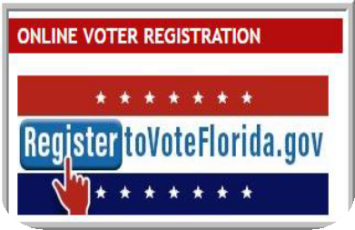
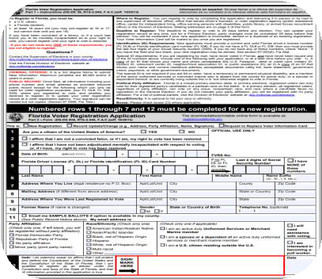

Voter Registration Options
Direct applicant to computer with a link to registertovoteflorida.gov to submit electronically with confirmation receipt or to prepopulate statewide voter registration application for printing
Offer paper application and assist at the same time you provide agency core services
Paper
If the application to receive agency services is processed over the phone, offer to mail the person a voter registration application

Slide 36

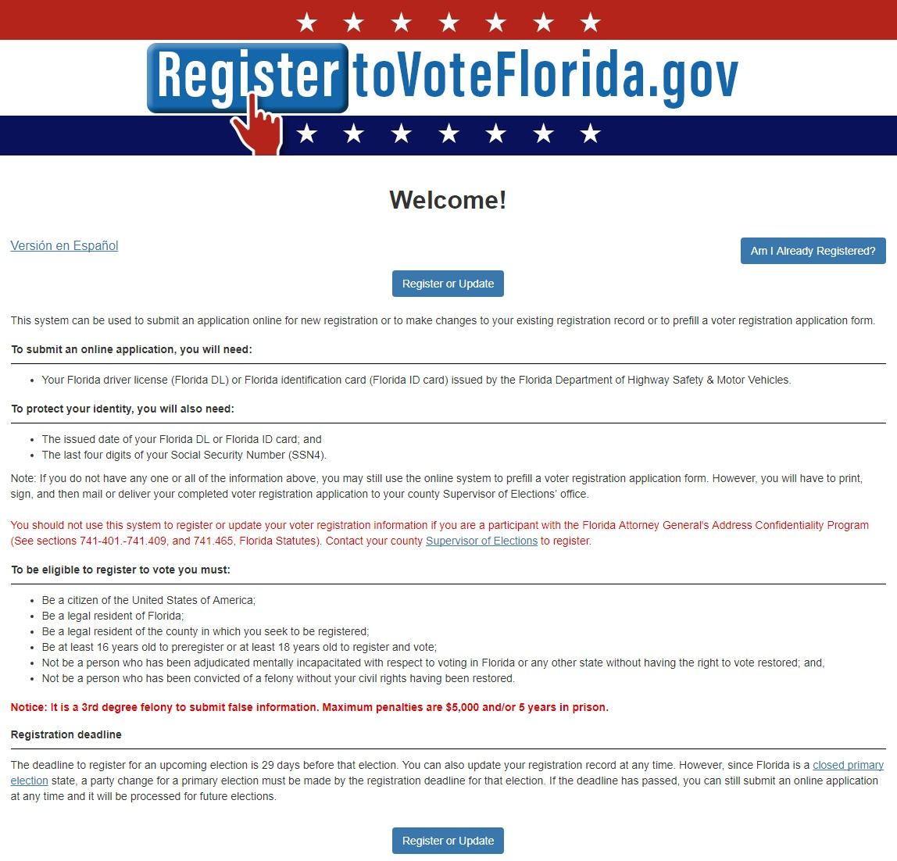
DOS Online Voter Registration System (OVR)
Available to any eligible voter at anytime from anywhere
English and
Spanish
37

Slide 37
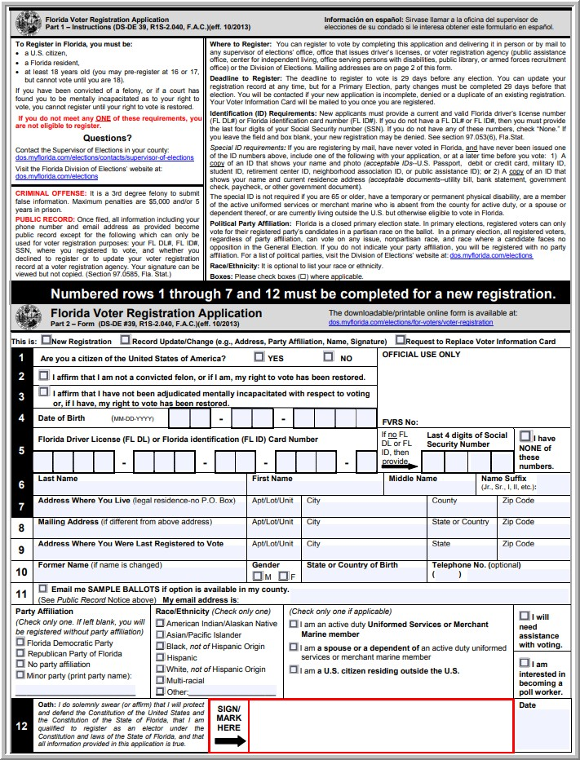
Paper Applications
Statewide voter registration application form
In English and Spanish
Options:
  Printed from online voter registration system
  Downloadable form available
online
  Hardcopy completed in person by hand
  Delivered in person or by mail

Slide 38
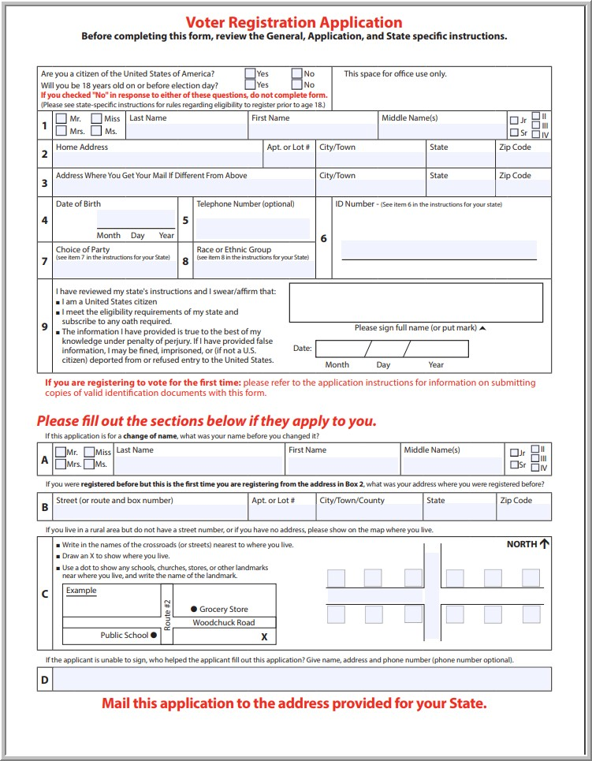
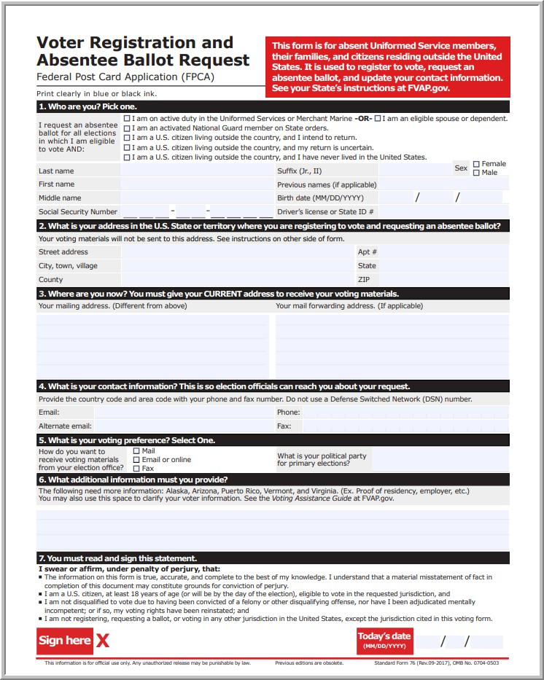
Other Acceptable Paper
Applications Forms
NATIONAL MAIL-IN APPLICATION FORM
FEDERAL POST-CARD APPLICATION FORM

Slide 39
Name (First, Last, Middle)
Date of Birth (MM/DD/YYYY)
Address (legal residence)
Checkbox relating to U.S. citizen
status
Checkbox relating to felony conviction and restored right to vote
Checkbox relating to a court order of mental incapacity and restored right to vote
Personal Identifying Number (FL DL, /FL State ID or SSN4 or if none issued, check “NONE”)
Signature (original, by applicant only, may sign with “X” if physical disability)
Required Fields
40

Slide 40
Phone number
Former name
Former residential address
Mailing address
Gender
Race/ethnicity
State or country of birth
Political party affiliation
Email address and option to receive sample ballot by email, if available
Military/overseas/dependent
Political Party Affiliation
Optional Fields

Slide 41
Why Are Optional Fields Still
Important?
Political party selection:
  Determines whether eligible to vote in primary election races
Former name:
  Identifies prior registration record with other name
Former out-of-state address:
  Helps notify other states to cancel registration in prior
state

Slide 42
Why Are Optional Fields Still
Important?
Request for assistance at polls:
  Enables voter to get help at the polls without having to
fill out another oath for help
Contact information:
  Allows SOEs to contact voter about registration or ballot issue
Want to be a poll worker:
  Provides SOEs with pool of potential temp staff for election cycles

Slide 43

Political Party Affiliation
Florida is a Closed‐Primary State:
  Party designation affects right to vote in party races in primary election
  Voters registered with one party cannot vote for
candidates of another party in a primary
  Voters with No Party Affiliation cannot vote party races in a primary
  But all voters, regardless of affiliation or no affiliation, can vote on any issue, and nonpartisan race, or any race in which a partisan candidate will face no opposition in the general election

Slide 44
Political Party Affiliation (continued)
Voter’s options:
  Major parties:
    Florida Democratic Party
    Republican Party of Florida
  Minor parties
  No party affiliation (NPA)
Parties periodically disband and new parties form:
  Always refer first to the most current political party list available online
  dos.myflorida.com/elections/candidates-
committees/political-parties

Slide 45










Undue Voter Influence § 97.058 (8), F.S.
Do not say or do anything that discourages someone from registering to vote
Do not reveal any person’s registration information for any
purpose other than administration of voter registration
Do not influence or try to influence someone to pick a particular political party
Do not display any political party affiliation or party allegiance
Do not make any statement or take any action which leads applicant to believe decision to register or not register will impact availability of services

Slide 46

How to Assist
Same level of help as you provide for other agency services
Same options for access as you provide for your agency’s application, renewal, or update process.
Online system
  In person
  By mail
  Over the phone
  Home site visit
Encourage person to read all instructions

Slide 47
How to Assist (con’td)
If applicant asks for help:
  You can help write/type information in, but the applicant must sign
  You are not responsible for an applicant’s choice to leave a required or optional field blank but if you notice blank field, bring to his or her attention
  You are not responsible to know whether applicant is eligible to register

Slide 48

Application Processing
If electronically submitted online (ww.registertovoteFlorida.gov):
  No further action
If printed (www.registertovoteFlorida.gov or online):
  Review application for blank fields before the person leaves
  Stamp date of receipt on application
If received by mail:
  Keep envelope with application regardless of clear or no postmark
If dropped off in-person or completed at your agency:
Review application for blank fields before the person leaves
Stamp date of receipt on application
Transmit all received paper applications (and postmarked
envelopes) to local county SOE office within 5 calendar days

Slide 49
Vot er ’s Initial Registration Date
Determined by the Supervisor of Elections’ office based on:
  Date of electronic submission online
  Date stamped as hand-delivered to voter registration agency
  Date of receipt as hand-delivered by Supervisor’s office, or
  Postmark date on mailed envelope
  If no postmark or postmark is unclear, the date received is the registration date unless received within five days after registration deadline, then registration deadline becomes registration date

Slide 51
Non-Compliance
SECTION FIVE

Slide 52
Non-Compliance with NVRA -
Action
Any person who alleges violation of voter registration or removal process under NVRA or Florida Election Code can file a complaint against DOS, SOE, DHSMV / Tax Collector, or a Voter Registration Agency
NVRA complaint filed with the Department of State:
dos.myflorida.com/elections/forms-publications/forms/complaint-forms/

Slide 53
Non-Compliance with NVRA -
Remedy
Award of attorney fees and other sanctions
Declaratory and injunctive relief by U.S. Attorney General/Department of Justice
Criminal penalty for knowing and willful violations
Maximum 5-year prison for intentional threats, intimidation, or undue influence as to a person’s ability to register or to vote, or for fraud in voter registration application process

Slide 55
Key Dates and Contact Information
SECTION SIX

Slide 56
Elections Key Dates 2020
Registration deadline/bookclosing
    Presidential Preference Primary Election: February 18, 2020
    Primary Election: July 20, 2020
    General Election: October 5, 2020
2020 Election Dates
    Presidential Preference Primary Election: March 17, 2020
    Primary Election: August 18, 2020
    General Election: November 3, 2020

Slide 57


Contact Information
Division of Elections
Katrina Ferguson, Statewide Training NVRA Coordinator
• 850-245-6237
  Katrina.Ferguson@DOS.MyFlorida.com
    dos.myflorida.com/elections/for-voters/voter- registration/national-voter-registration-act
Local County SOE
Supervisor of Elections
Contact information online at Division of Elections’ website
  dos.myflorida.com/elections/contacts/supervisor-of- elections
57

Slide 58

FLORIDA DEPARTMENT
of STATE
For more information, visit us online at:
dos.myflorida.com/elections/
58

