Slide 1
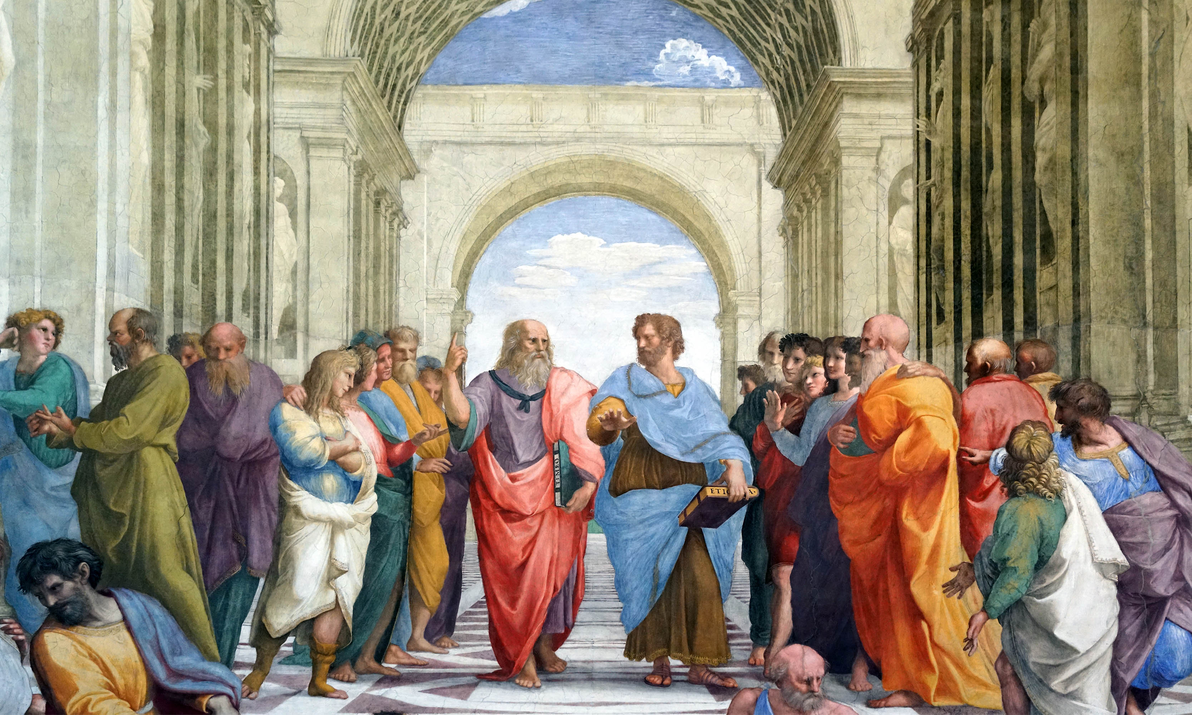
A Library Renaissance
R. David Lankes

Slide 2
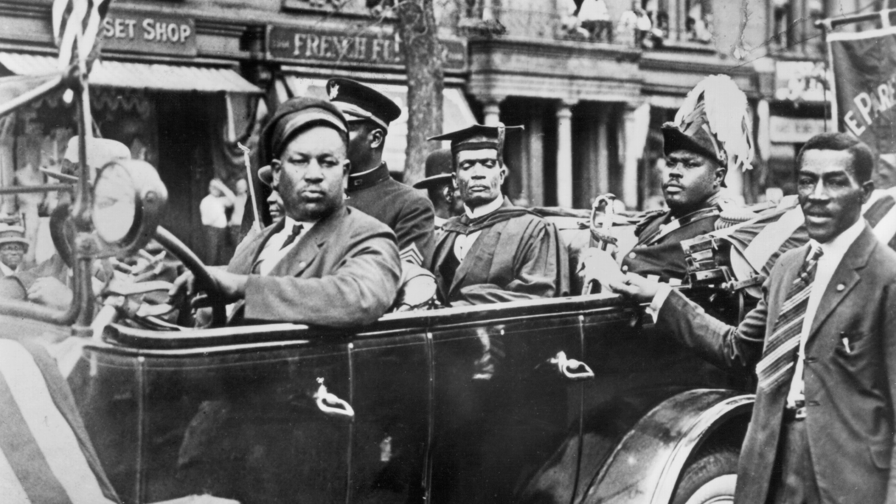
A Library Renaissance
R. David Lankes

Slide 3
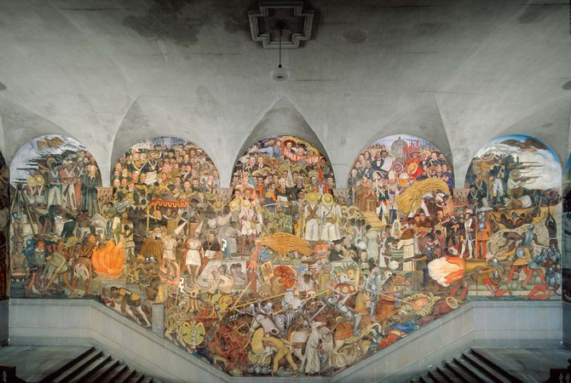
A Library Renaissance
R. David Lankes
Notes:
Mexican Rennaisance Mosiac movement two decades of artistic production following the Mexican Revolution (1910–21).

Slide 4
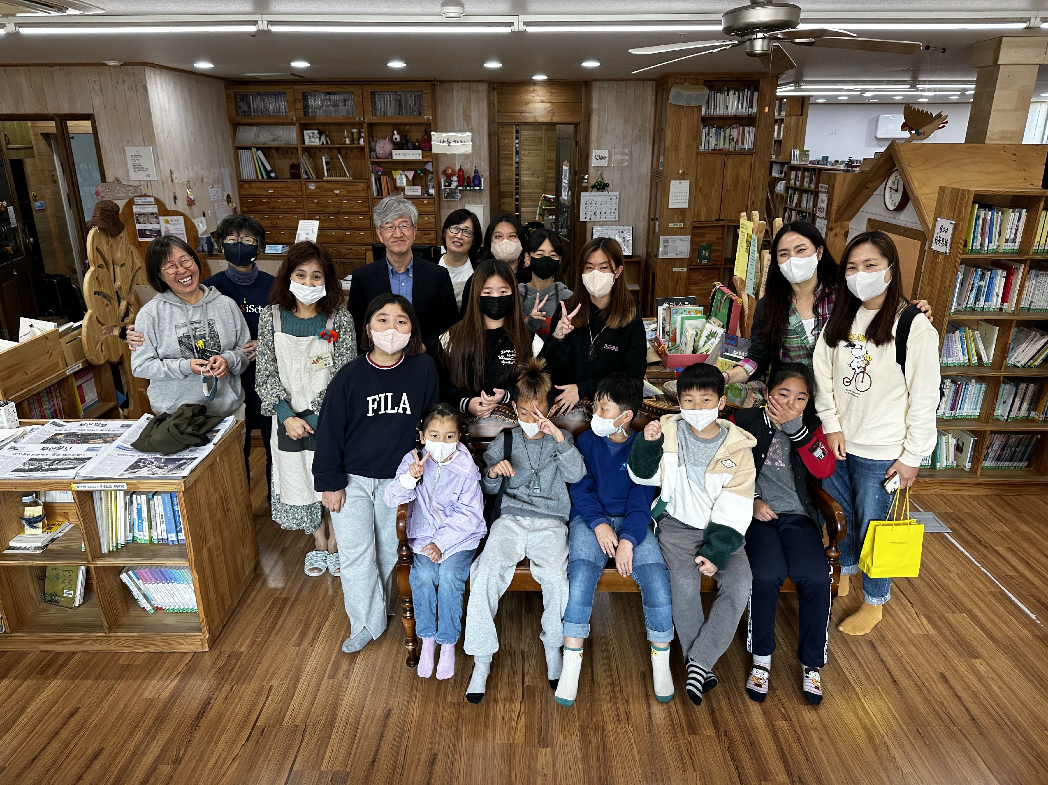
A Library Renaissance
R. David Lankes
Notes:
Or even in Korea

Slide 5
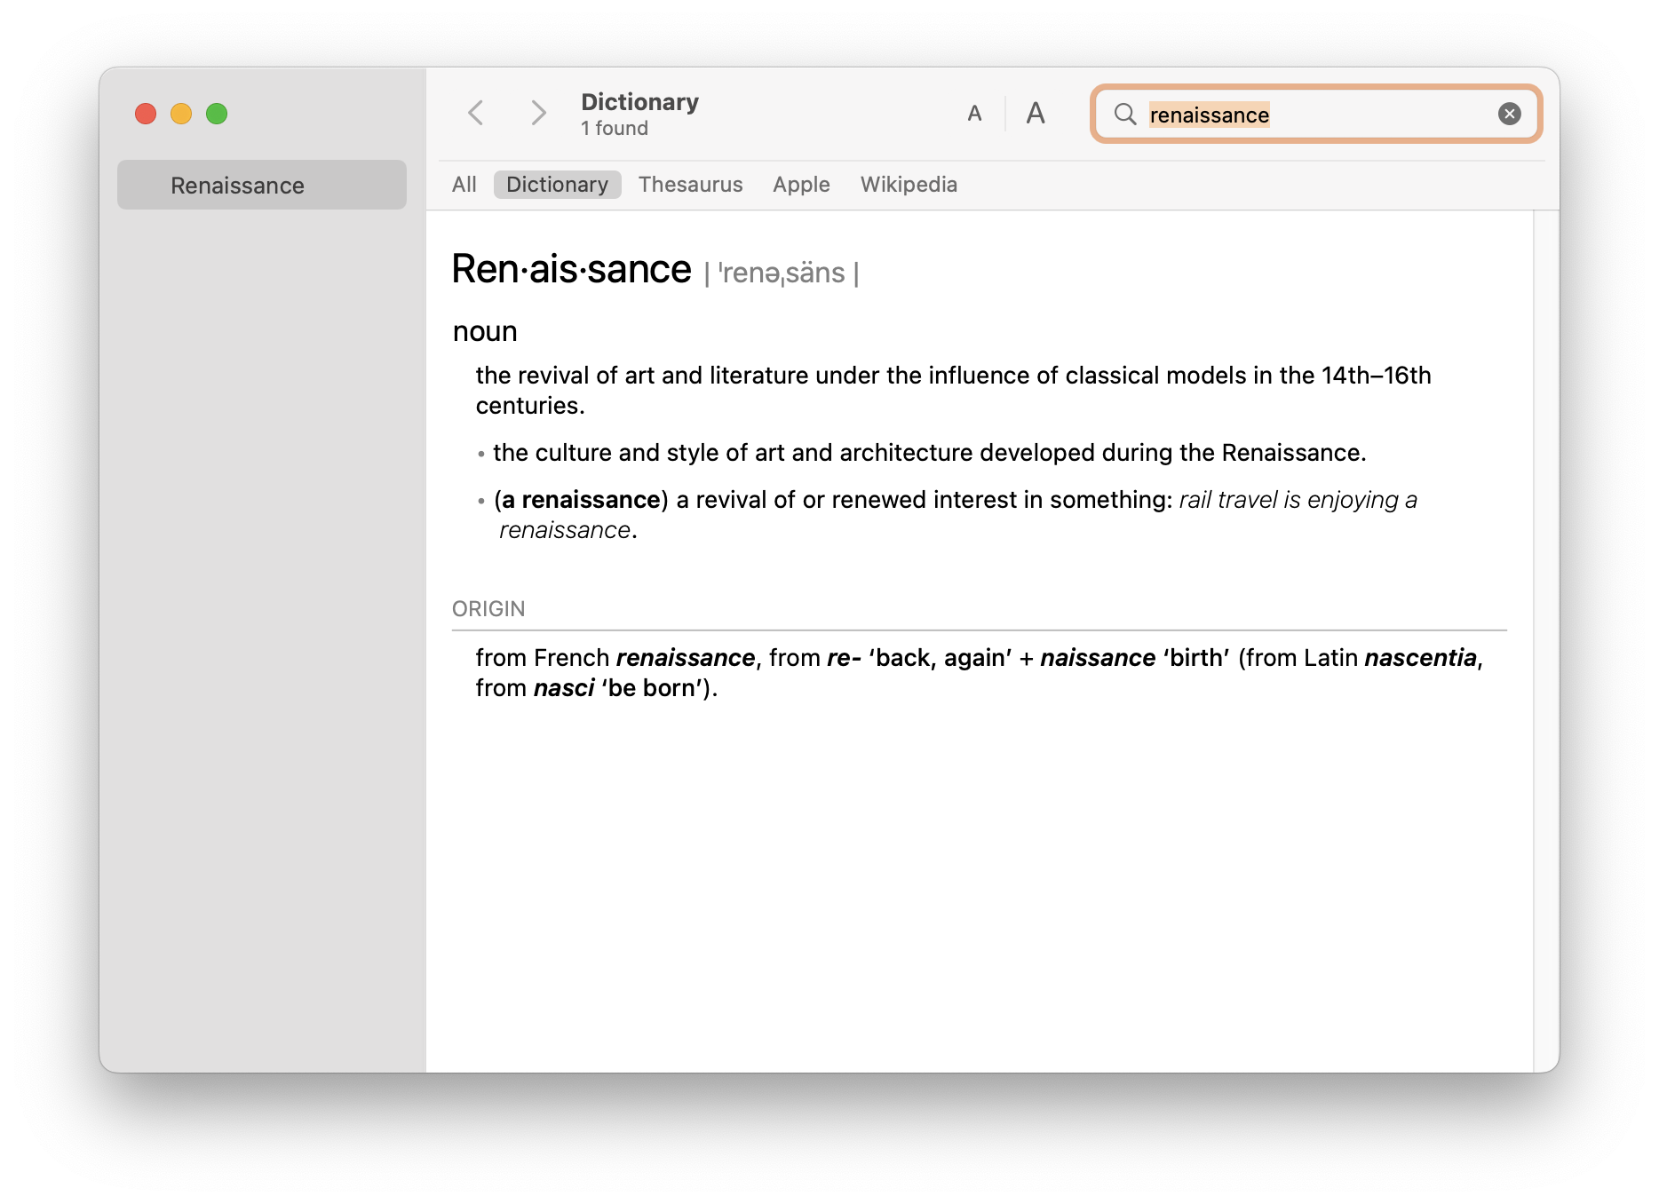

Slide 6
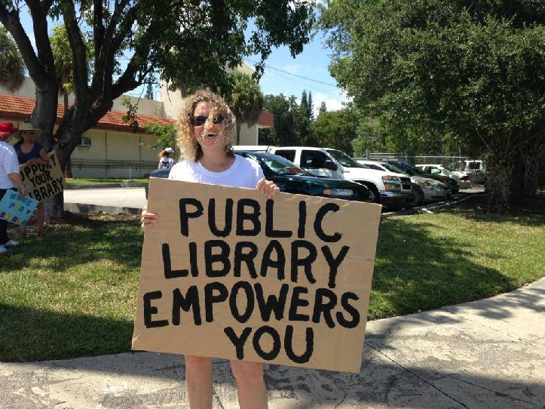
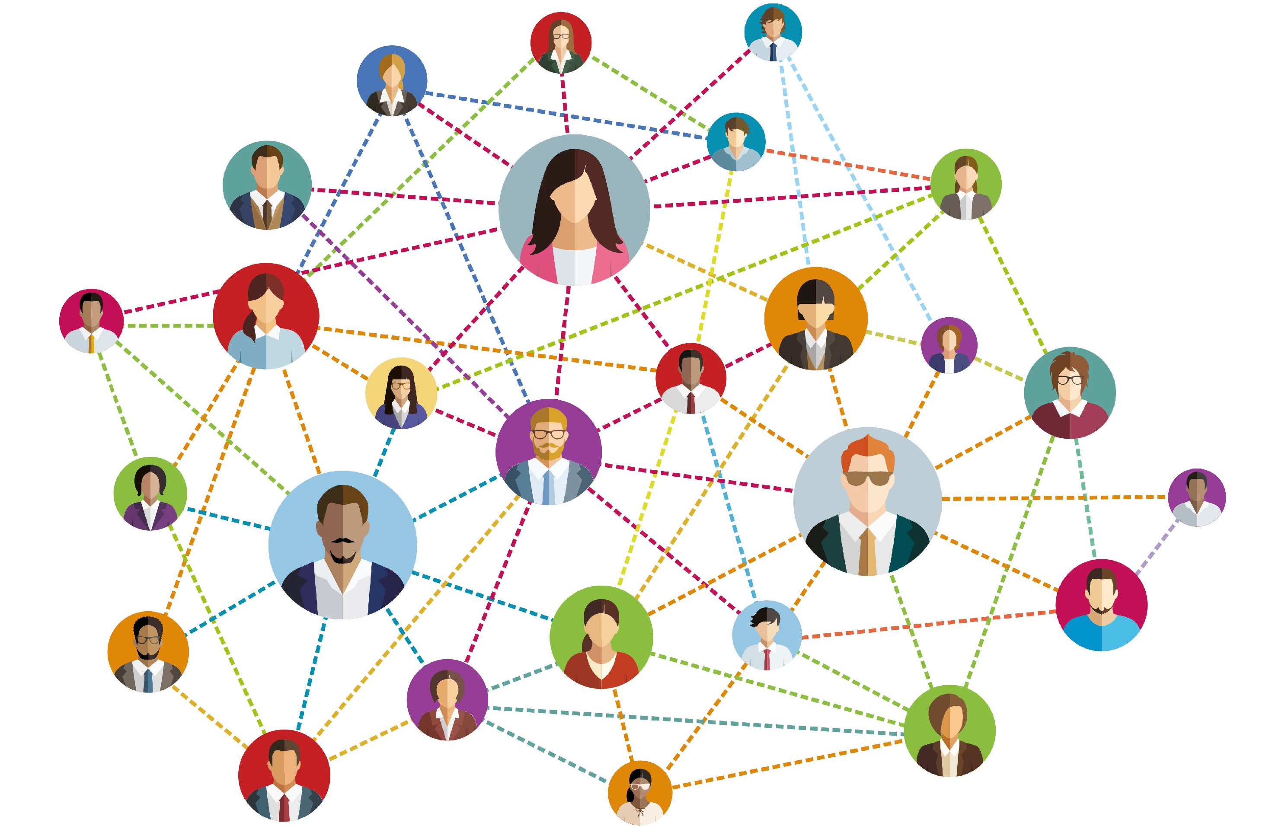
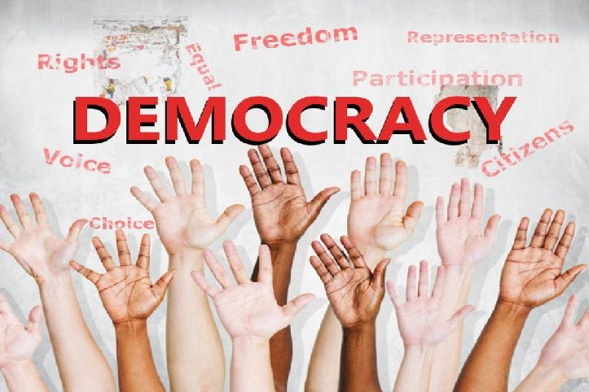
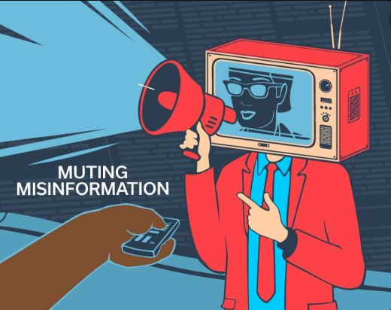
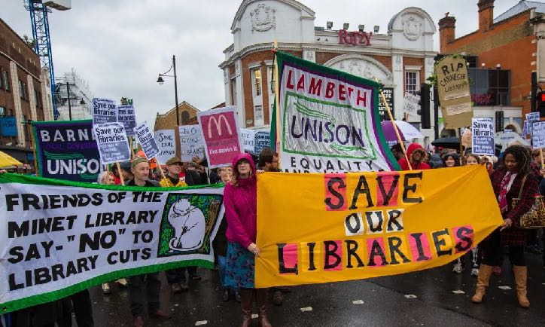
Notes:
o But I ask myself, how much more could we do as a library community.
o What more can we do if we transformed from professionals working in an institution, we truly become a network of peer activist empowering our communities.
o Imagine first a network of librarians weaving together our individual communities across issues of politics and social standing.
o Then linking these empowered communities, dedicated to democratic ideals across the country.
o And then imagine linking your network with those across the globe. Where your partner innovates in the hills of Texas. Where you share your success and ideas with a librarian in Kenya or Thailand or next door.

Slide 7
Notes:
o The central idea of new librarianship is that for thousands of years our predecessors and the libraries they built improved society.
o And over those years they changed. They went from serving empires to colonies to new democracies.
o They went from bamboo books to paper to digital data floating in the ether.
o Their tools changed. The communities they served changed. But the mission remains the same.
o The mission of librarians is…
o That mission and that history, forged through the ages lays a foundation for a new librarianship.
o Our communities, the communities that we are a part of, are hurting.
o We need to be radical agents for positive change.

Slide 8
A Librarian
Mission
The mission of librarians is to improve society through facilitating knowledge creation in their communities.
Means
Values
MAKE: Motivation, Access, Knowledge, Environment
Librarian
Learning, Openness, Intellectual Honesty (not Unbiased), Intellectual Freedom and Safety, Diversity
Notes:
o So what are we, librarians, when our buildings and tools change? Are we librarians in the internet? Are we librarians in maker spaces? What is a librarian?
o It seems like an easy question. It has taken me 14 years to find that answer.
o What ties us together in Korea or the United State in cities and universities. In organizations of hundreds or alone?
o Here’s what I came up with…

Slide 9
Librarian
Education
Title
Spirit
Notes:
I’m a believer in certification and formal education. It is not only efficient, but ensures values and worldview is instilled beyond skills. It is also invaluable for giving librarians a sense of legitimacy. But it can’t be the only way into the profession. We should purposely make the borders of our profession porous to let in innovation from beyond while fostering it within. When our titles become walls, and our skills rigid, we make it harder and harder to adapt to our dynamic community.

Slide 10
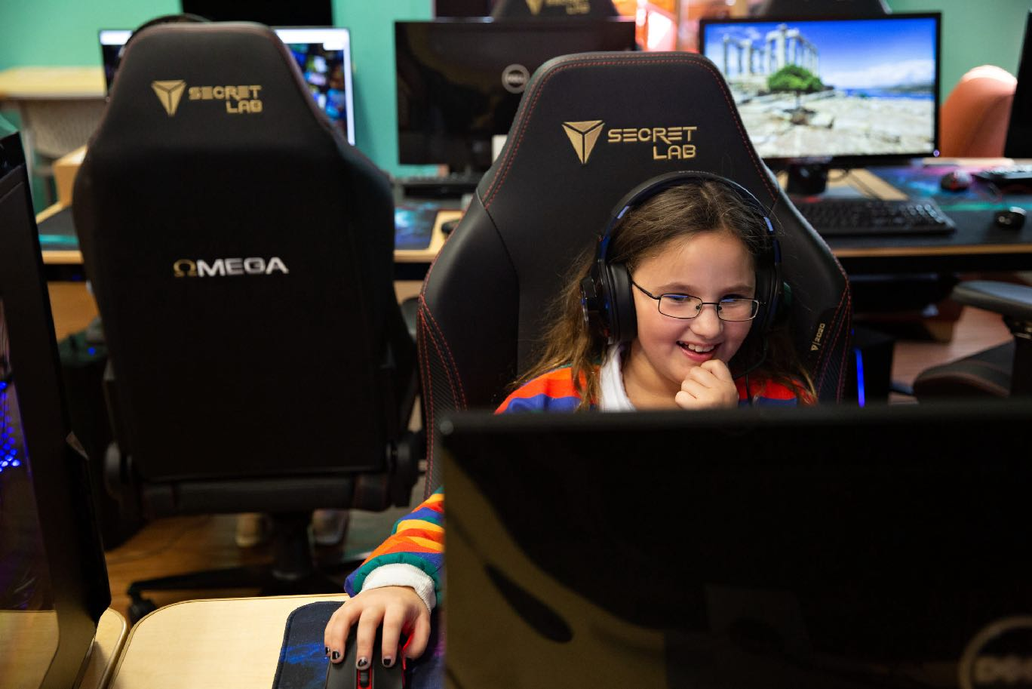
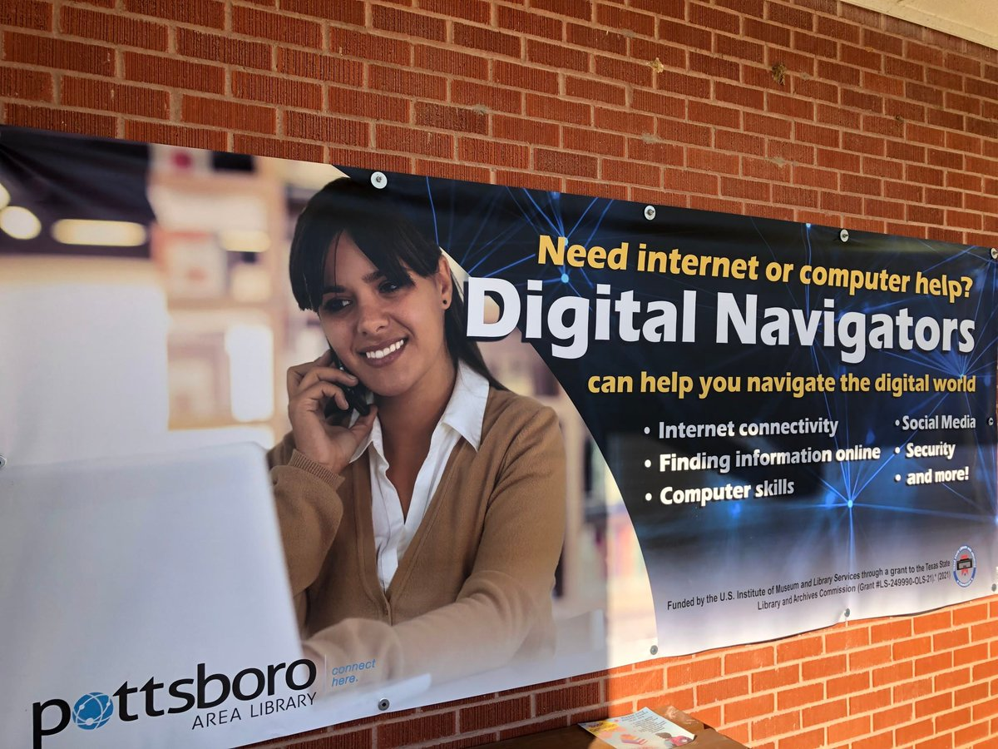
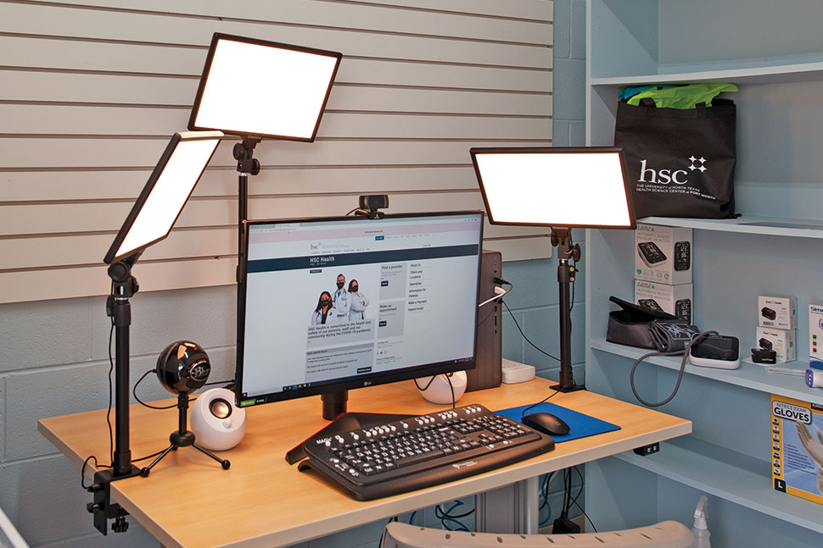
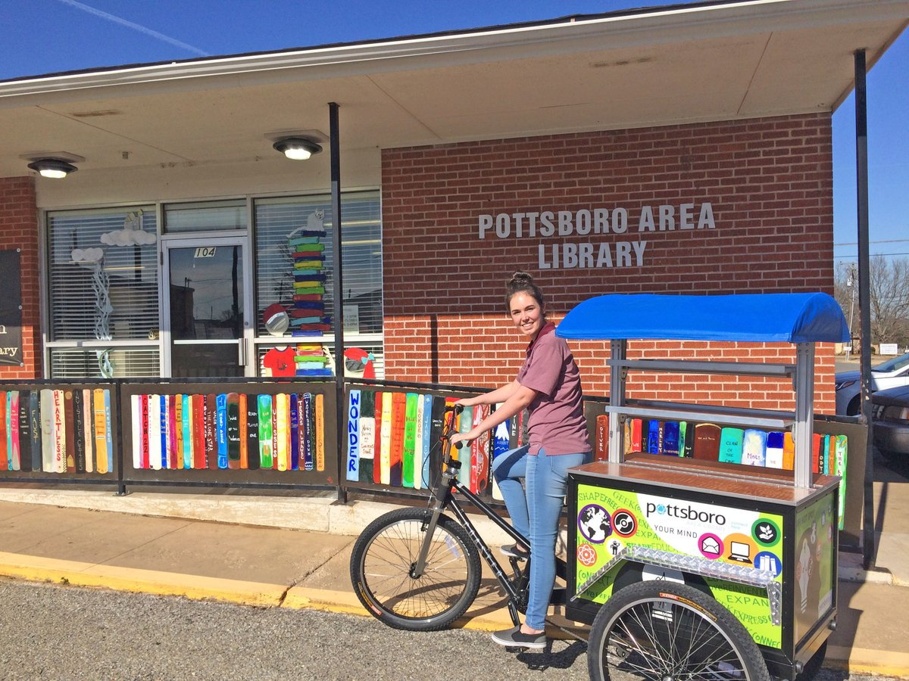
Pottsboro Public Library
Notes:
Texoma Lake

Slide 11
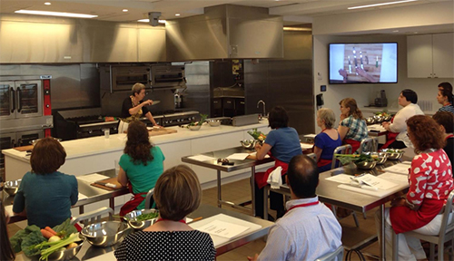
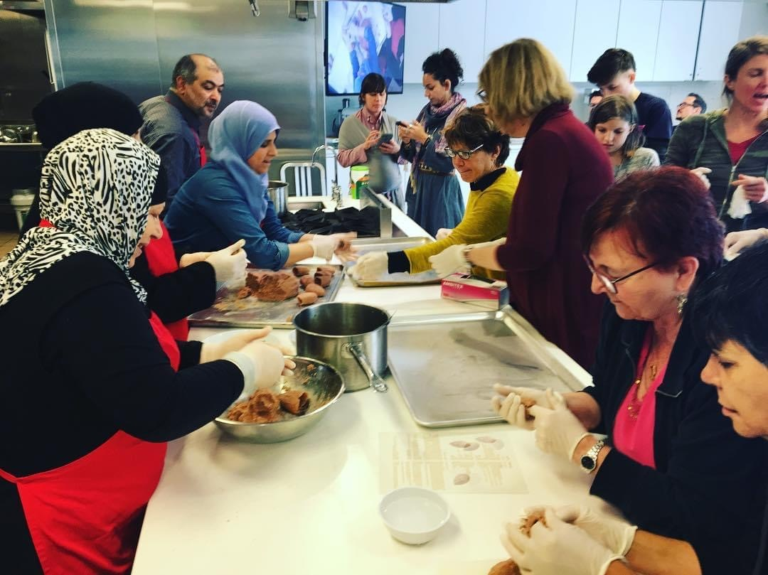
Philadelphia

Slide 12
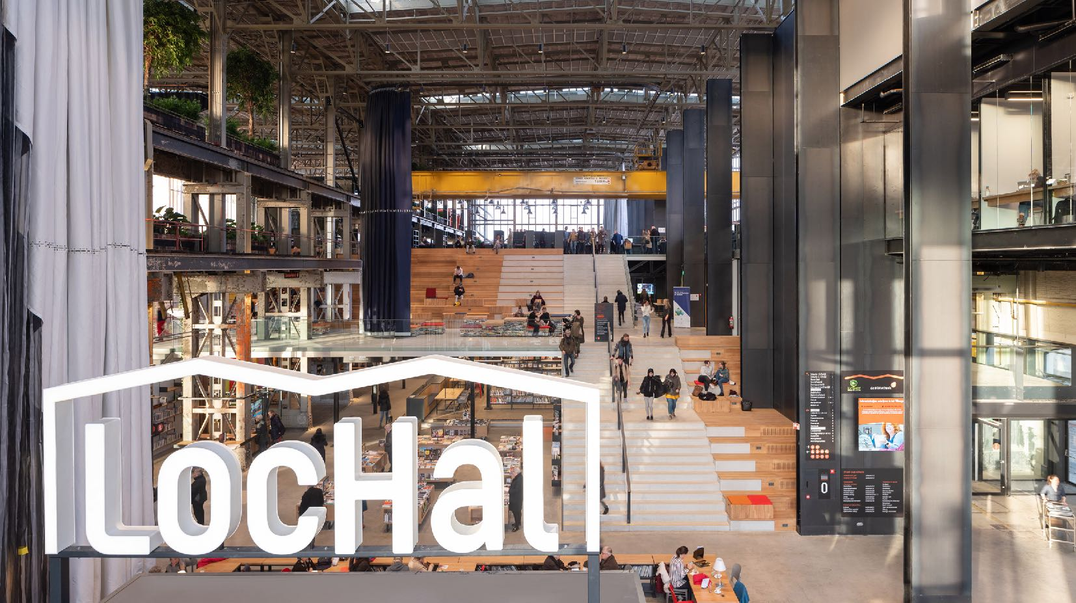
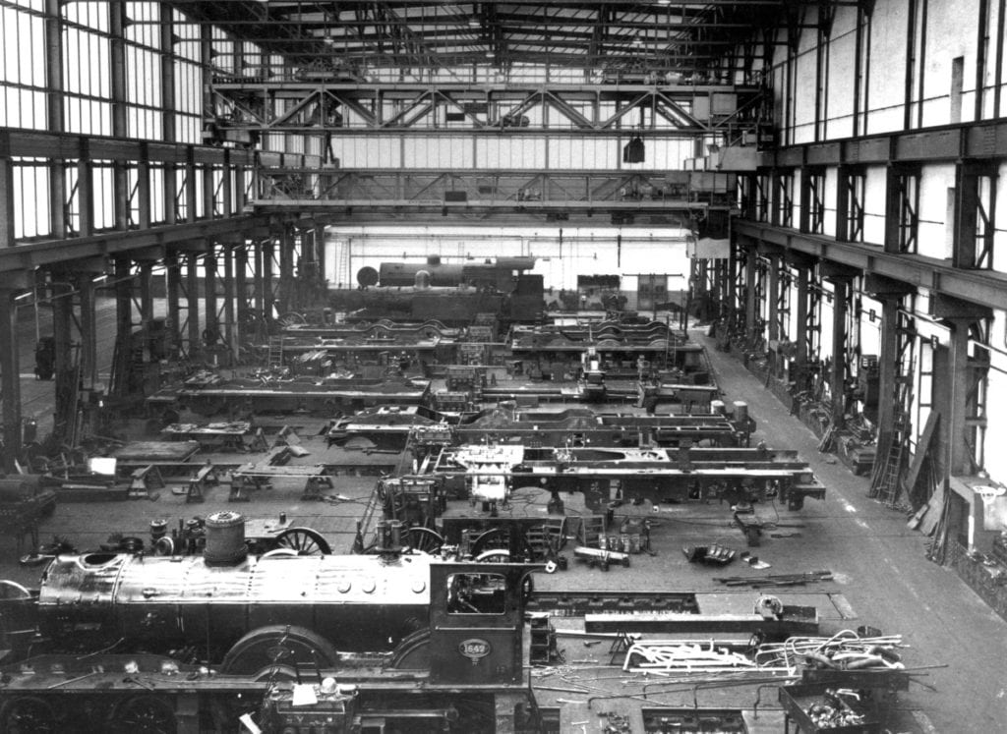
Tilburg: LocHAL

Slide 13
National Library of Korea
Motivation
Cultural History
Access
Digital to documents, and community-generated information
Knowledge
Tutorials, workshops
Environment
“User-based”

Slide 14
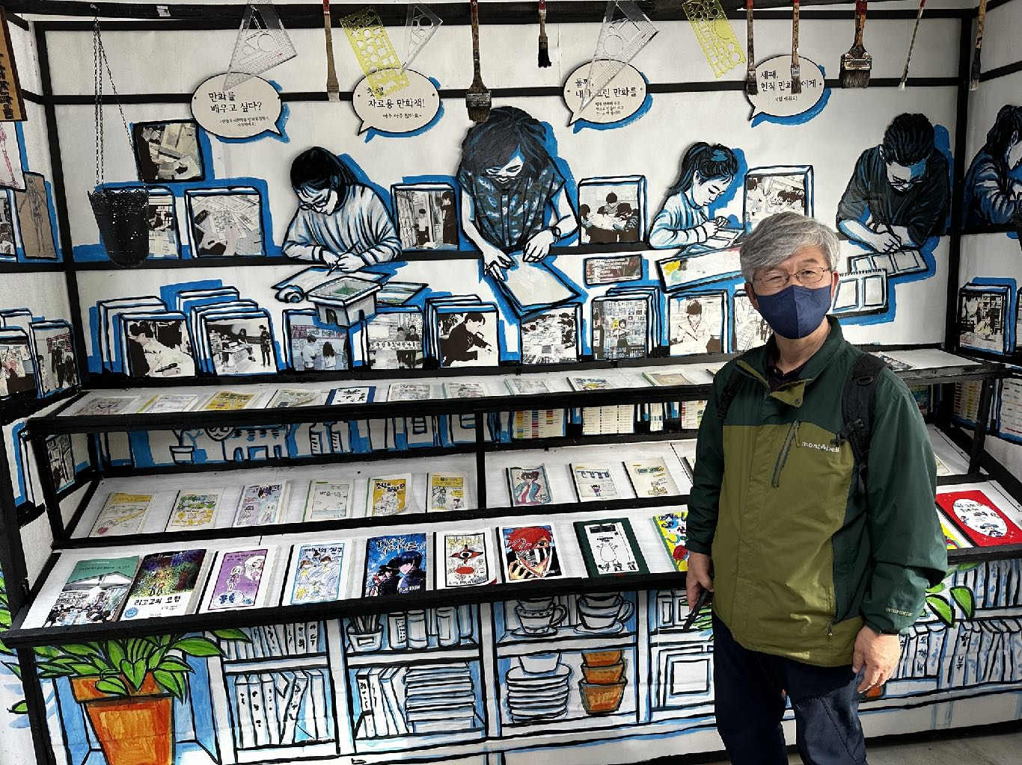
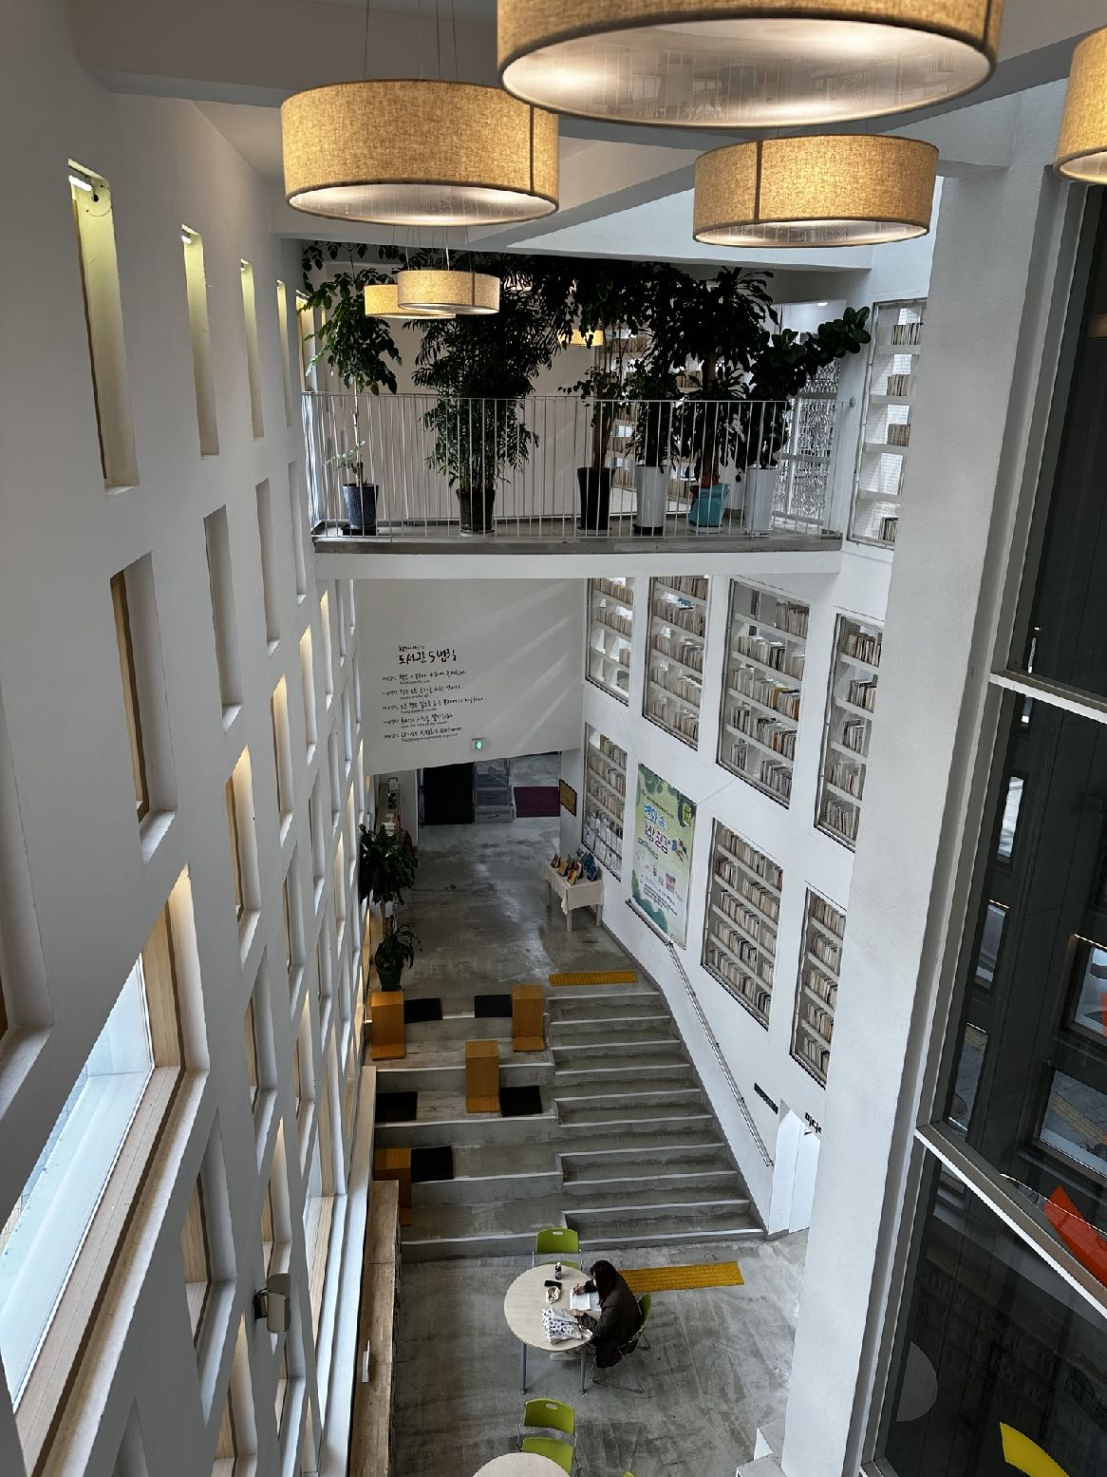
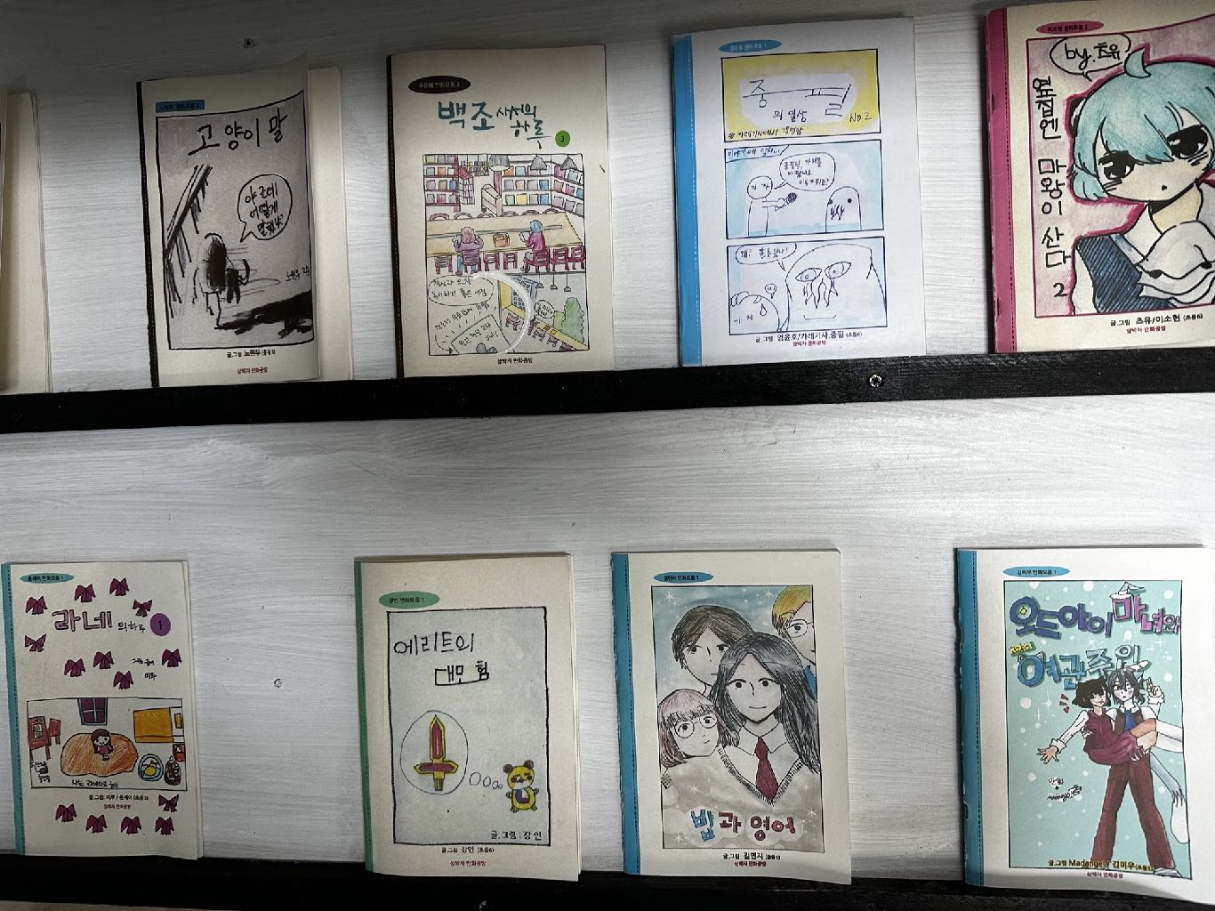
Gusan Library Village
Motivation
Community Improvement and Identity
Access
Materials, Clubs (reading, comics), Self Publishing
Knowledge
Peer Learning (“Library School”)
Environment
Of the Community (including in the architecture)

Slide 15
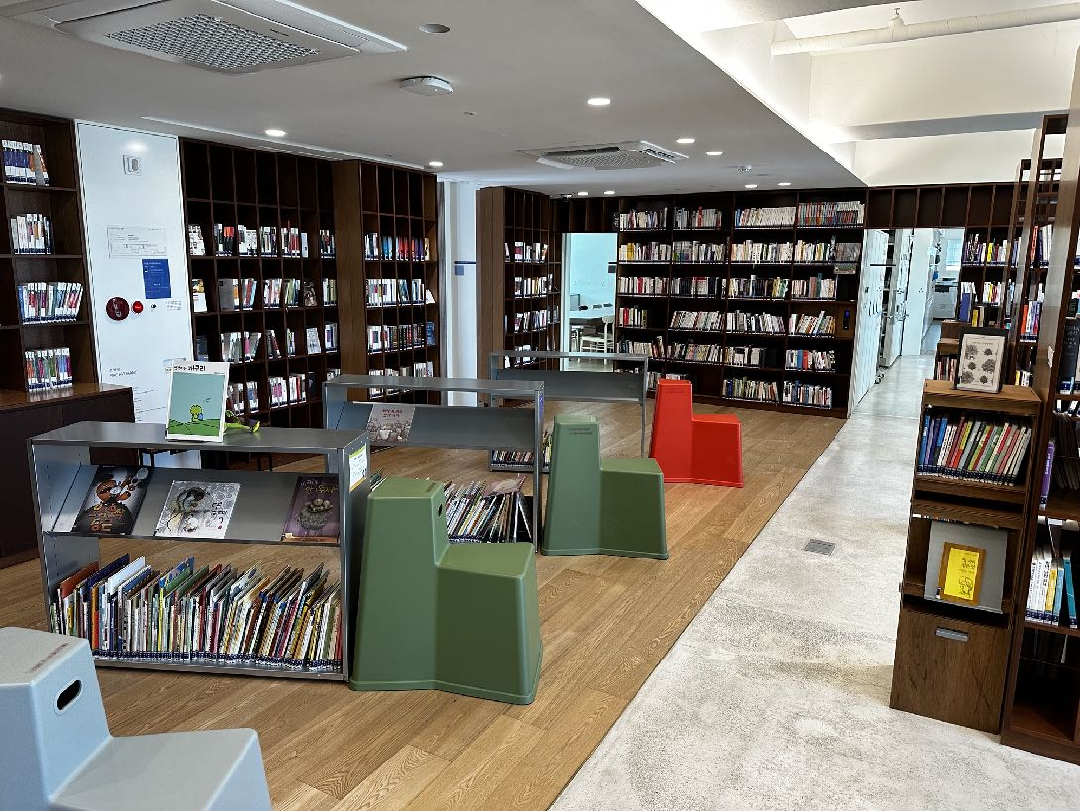
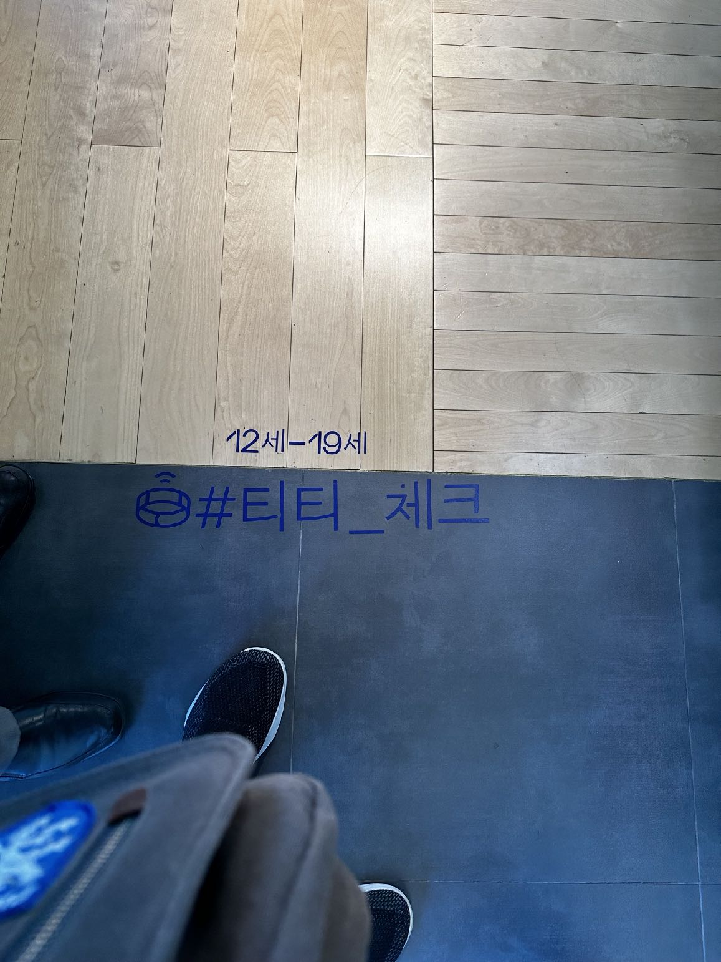
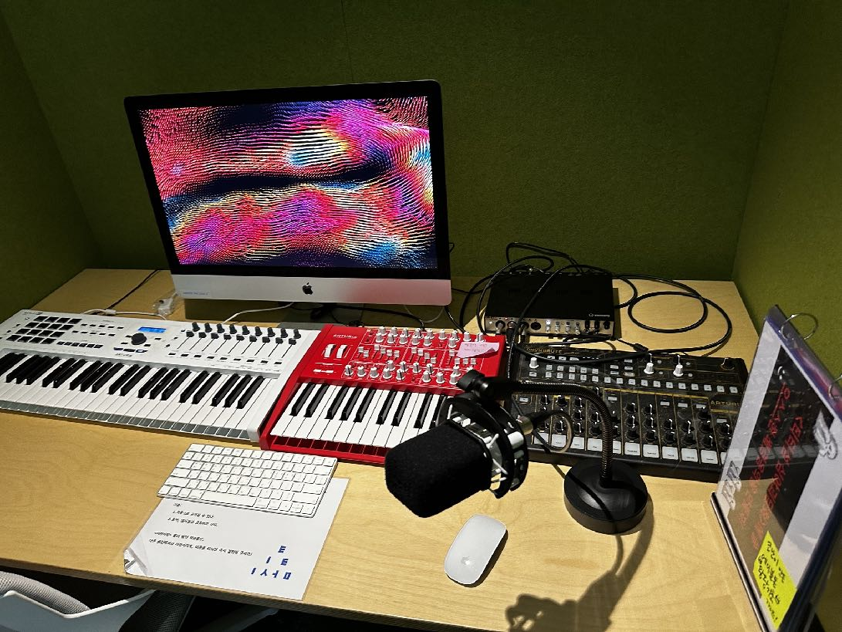
TT Island
Motivation
Teen & Tween Development and Self-Discovery
Access
Peers, Tools to Create, Possibilities
Knowledge
Peer Learning
Environment
Membership
Notes:
Talk See-art Foundation about starting with public library and you centers

Slide 16
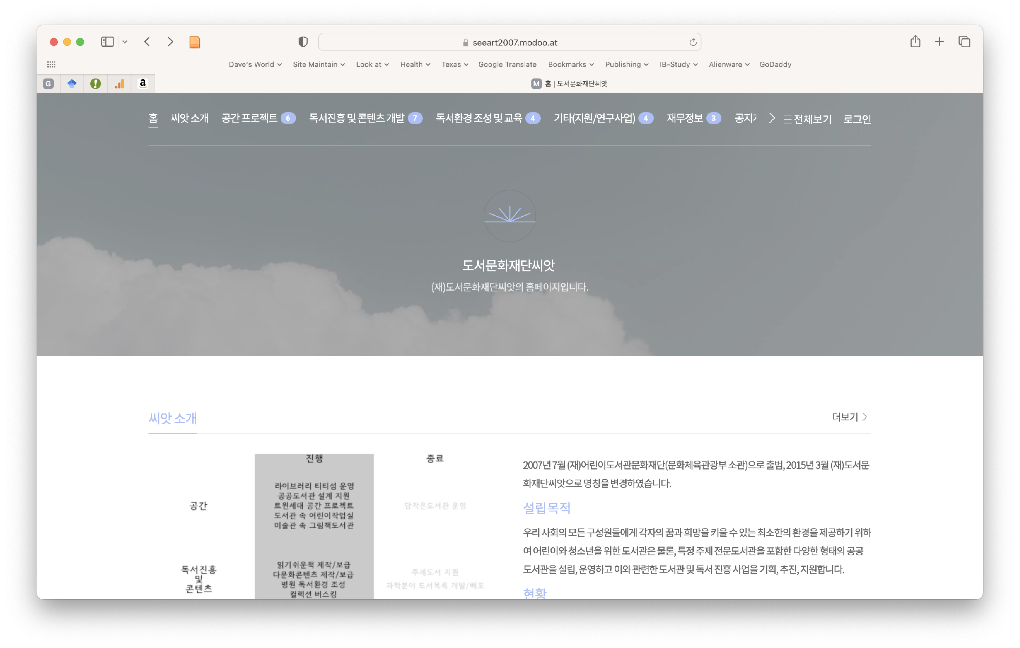
Library for Library Innovation

Slide 17
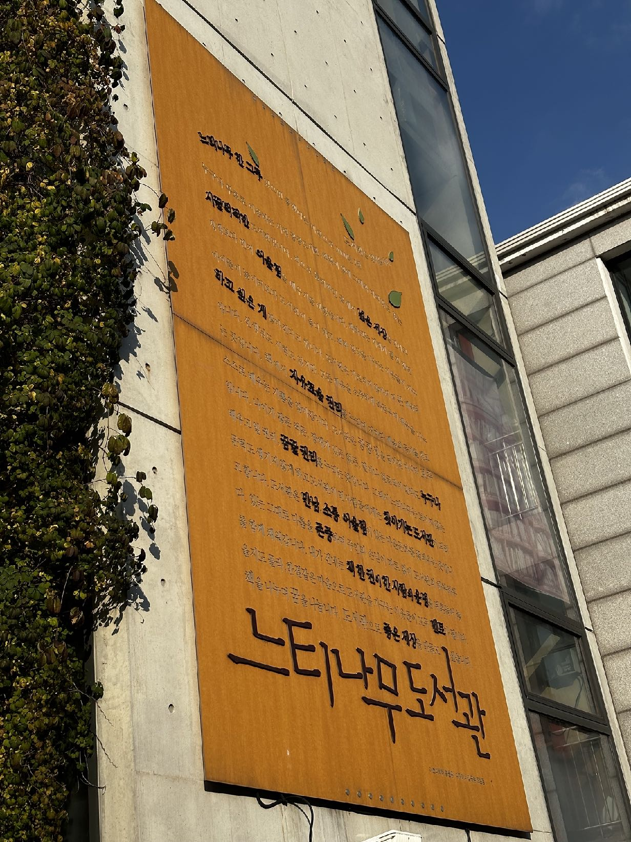
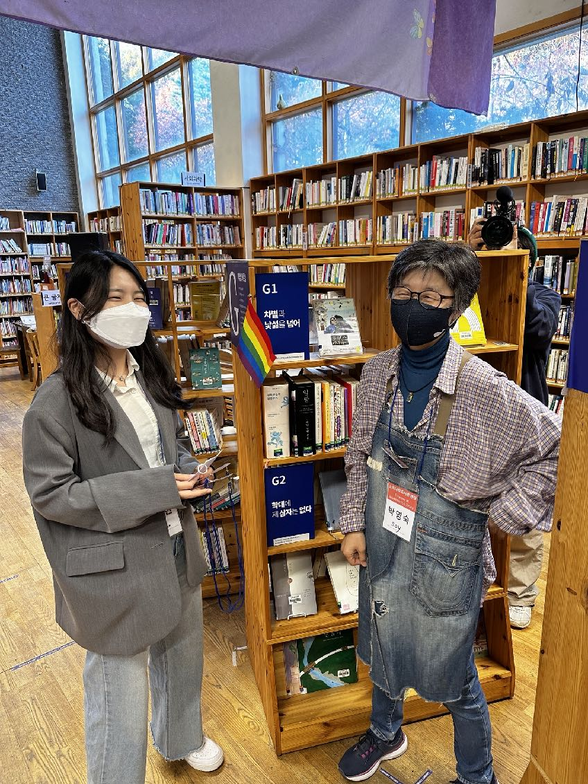
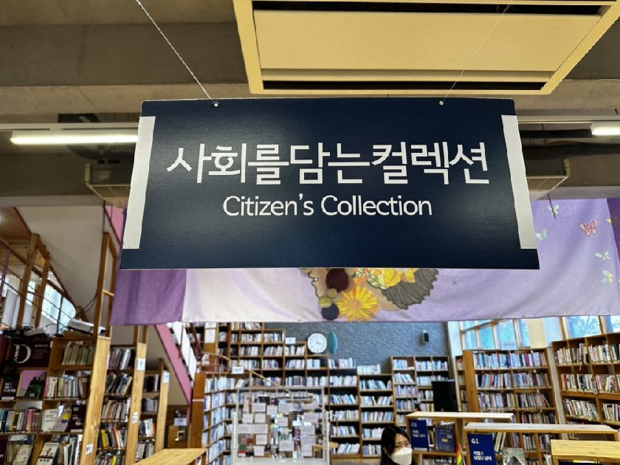
Neutinamu Library
Motivation
Community Engagement
Access
Citizen Collections, Learn Through Doing (garden, kitchen, maker space, community archive)
Knowledge
Symposia, Community Action (clipping service)
Environment
Hand Crafted

Slide 18
The Mission
The mission of librarians is to improve society through facilitating knowledge creation in their communities.

Slide 19
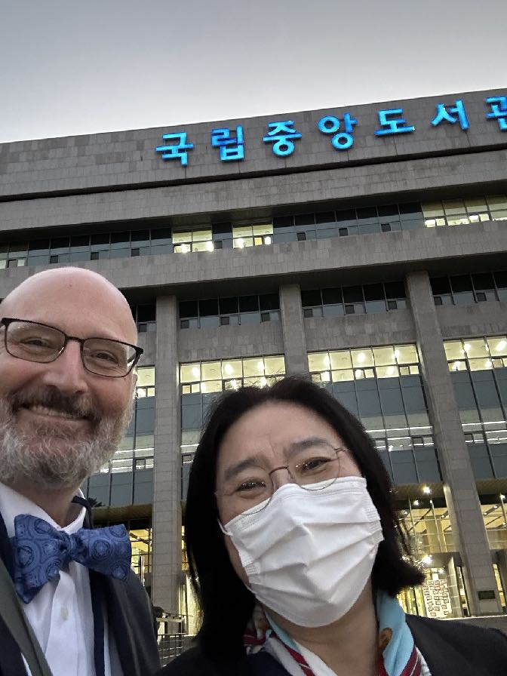
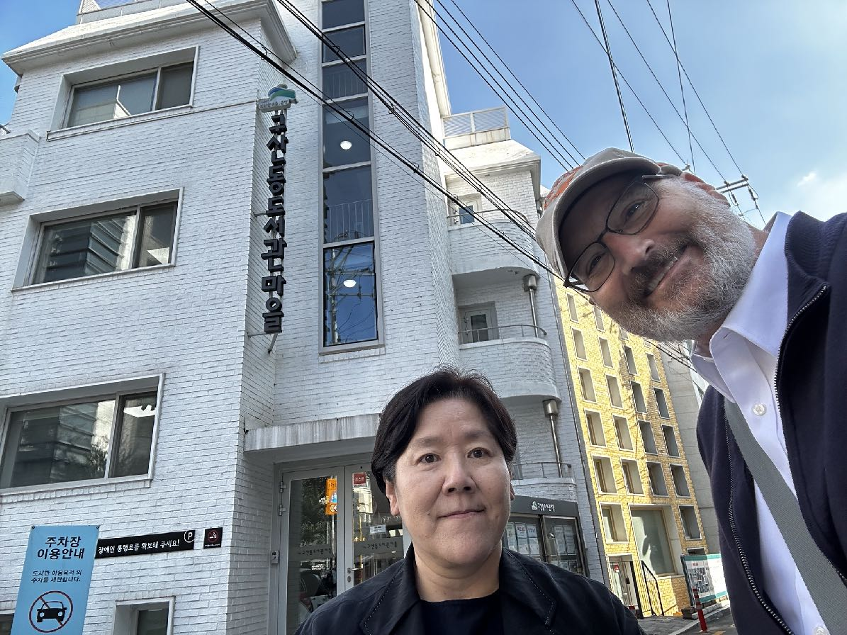
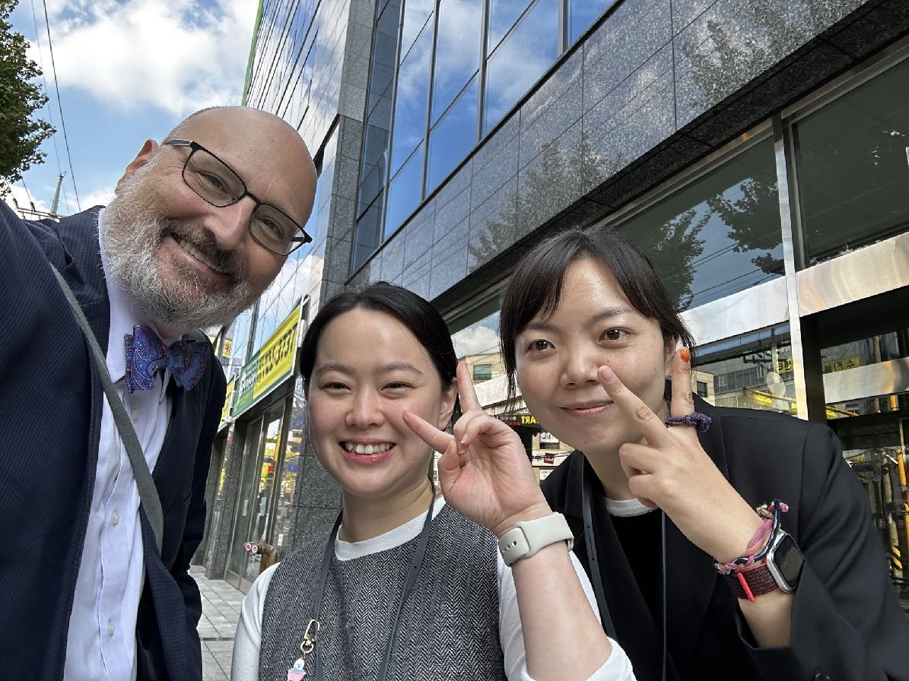
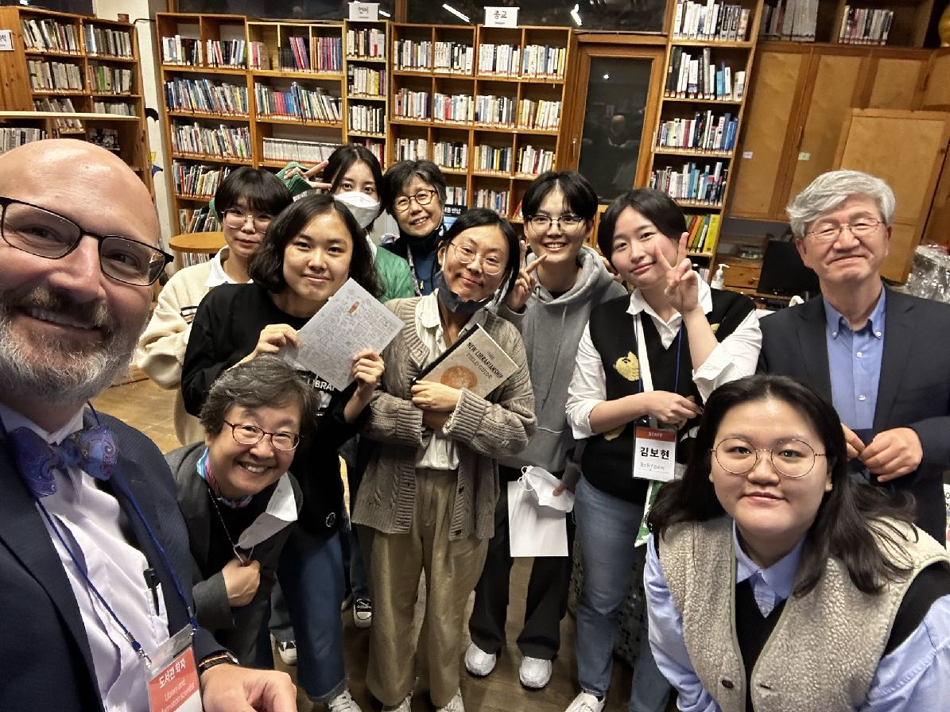
The Mission
The mission of librarians is to improve society through facilitating knowledge creation in their communities.

Slide 20
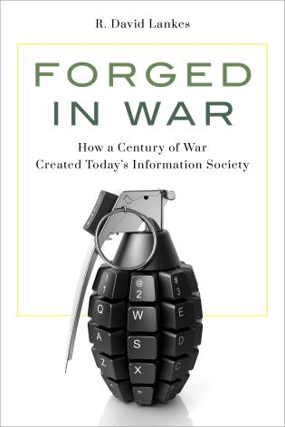
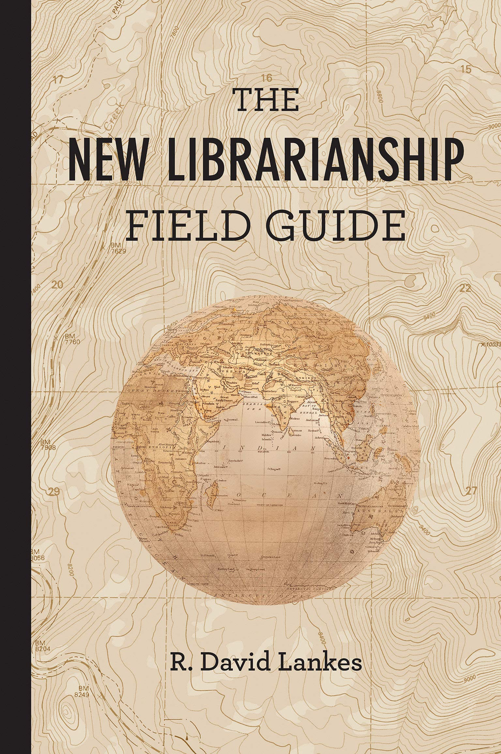
Slides @ https://DavidLankes.org
Libraries Lead Podcast: http://librarieslead.com

Slide 21
Image Sources
Slide 1: en.wikipedia.org/wiki/List_of_Greek_inventions_and_discoveries
Slide 2: metmuseum.org/art/collection/search/773549
Slide 3: open.edu/openlearn/history-the-arts/art-and-the-mexican-revolution/content-section-4
Slide 6: army.mil/article/235238/novel_research_speeds_up_threat_detection_prevention_for_army_missions
Slide 7: bibalex.org/SCIplanet/en/Article/Details?id=13521

